Slide 1
Index.
Overview … 2
Initial detection … 3
Mitochondria proofreading … 4
Deep learning model fine-tunning … 11

Slide 2
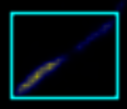
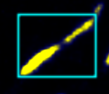
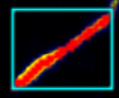
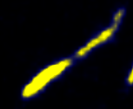
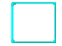
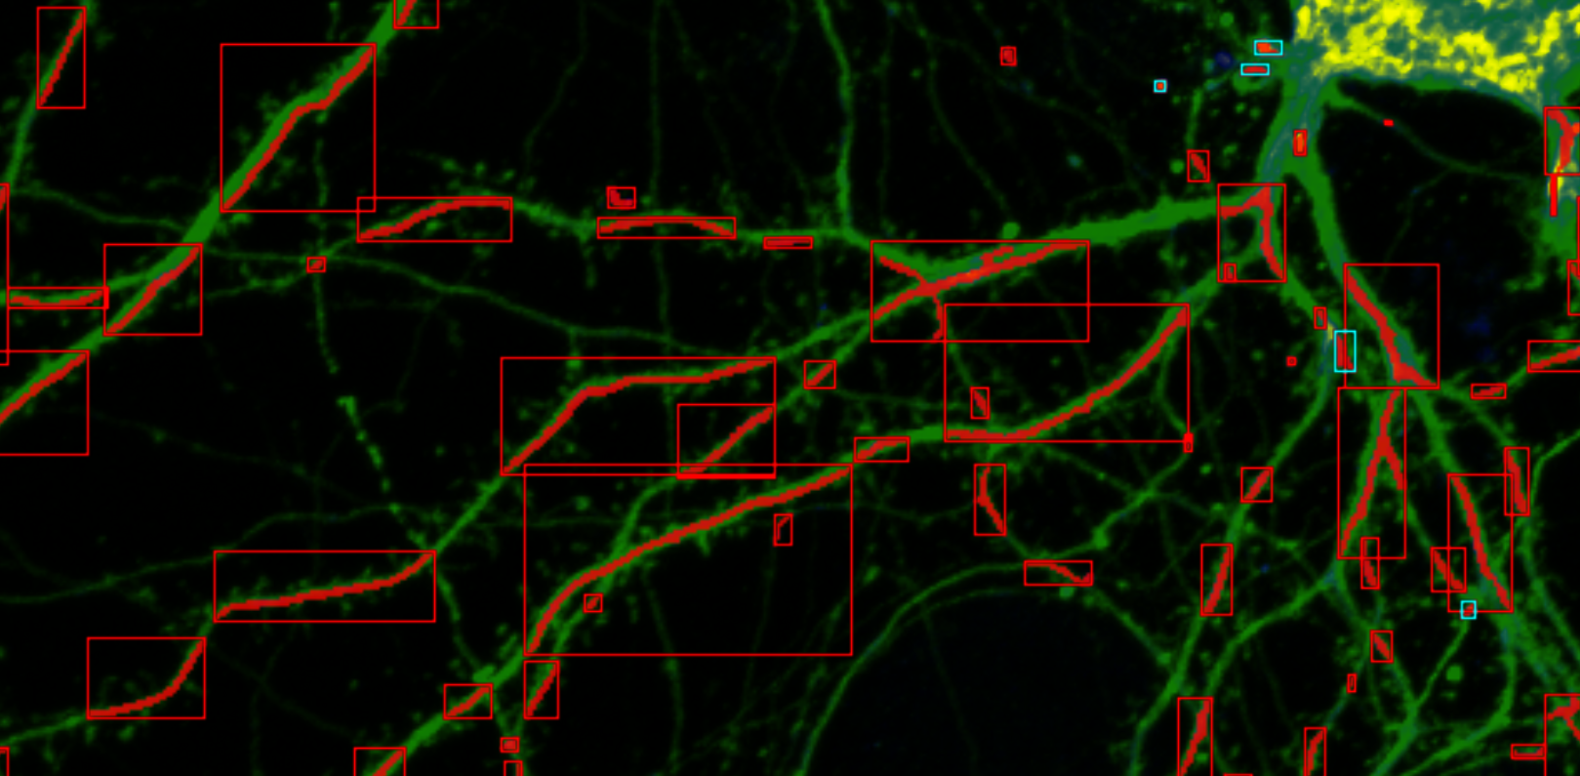
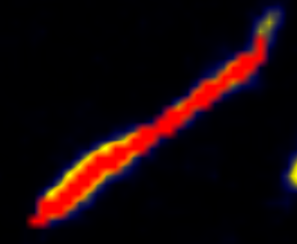

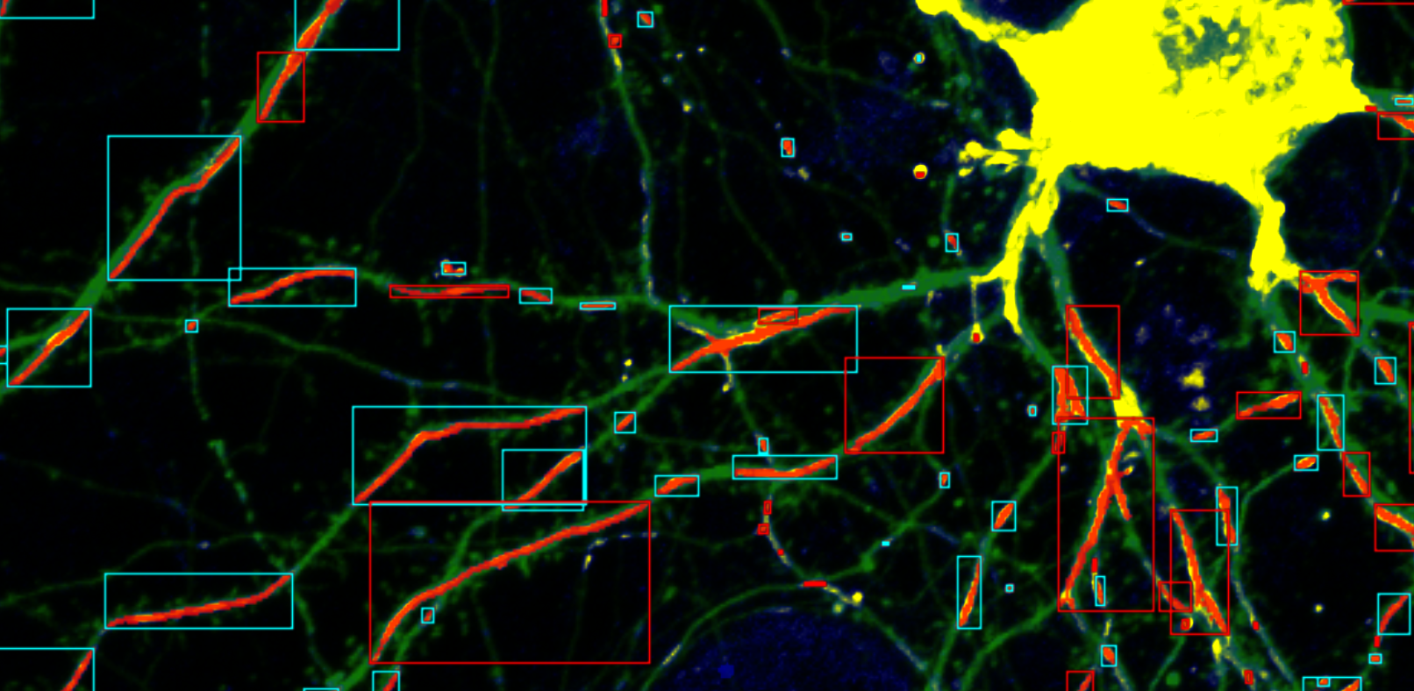
Overview
Raw Mito-mScarlet image
Signal improved image and object label
Background
Foreground
Corrected object label
User correction
Correct error part interactively
Initial detection
Refined detection
Fine-tunning & re-segmentation
Structure segmentation through pre-trained deep learning
If there are too many errors overall, fine-tunning the deep learning model through correction information

Slide 3
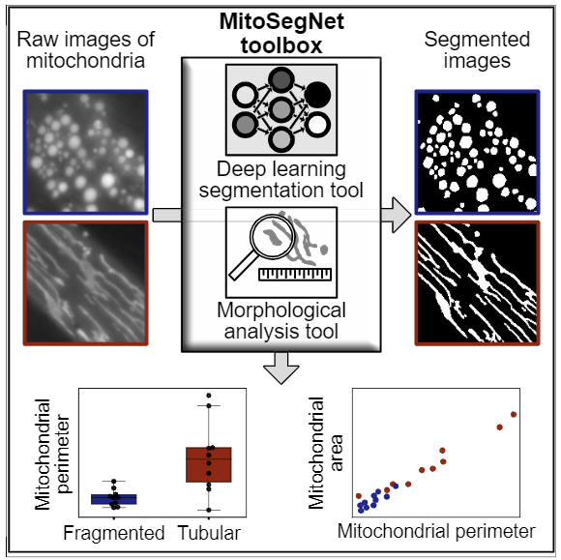
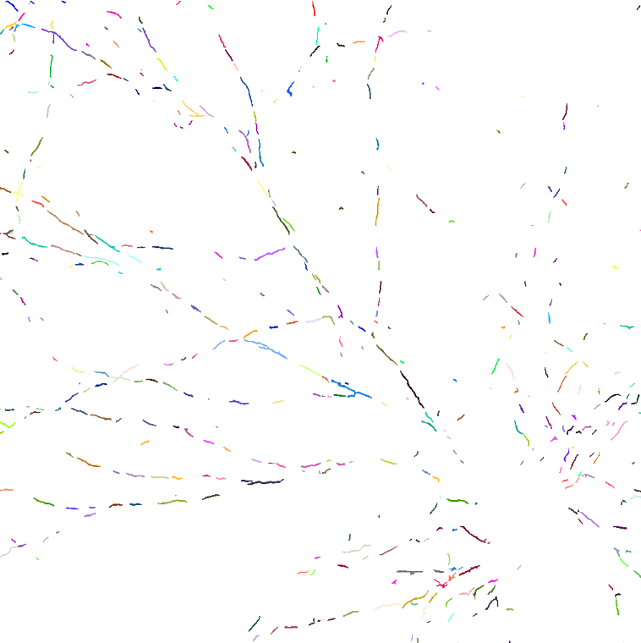
Initial detection
Fischer, Christian A., et al. "MitoSegNet: Easy-to-use Deep Learning Segmentation for Analyzing Mitochondrial Morphology." Iscience 23.10 (2020): 101601.
When the image is loaded, the pre-trained deep learning model automatically segments the mitochondria foreground and detects the objects through the connected component.

Slide 4
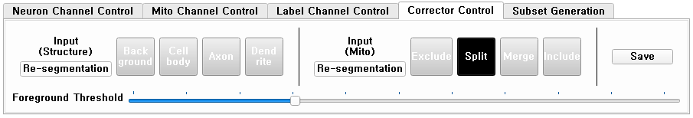
Mitochondria proofreading
Overlapped
Merged
Split
Noise
Missed
Possible error types of mitochondria detection
Error objects can be corrected through 4 interactions on corrector control panel
Exclude
Split
Merge
Include
Interactions of error correction
Guiding of error candidate parts
Background
Foreground
Exclude, Split interaction acts on the background part of the mitochondria channel image
Merge, include interaction acts on the foreground
User input
Propagated region
Raw Mito-mScarlet image
Signal improved image and object label
Corrected object label
Example

Slide 5
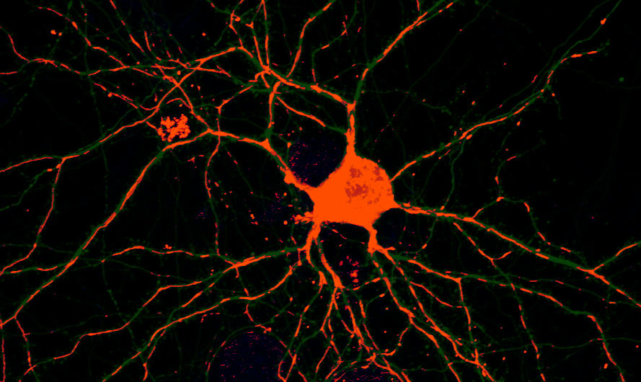
Mitochondria proofreading
When the foreground threshold is adjusted with the interaction selected, the foreground part of the mitochondria is displayed in red.

Slide 6
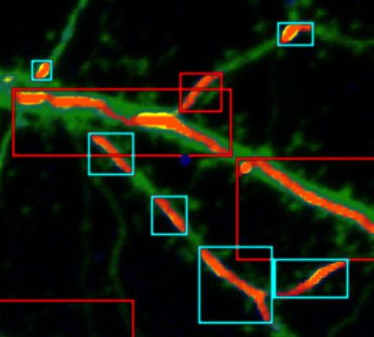
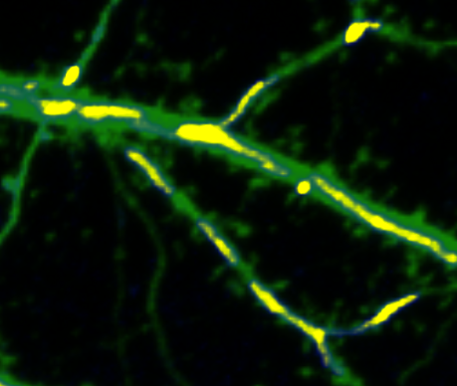
Mitochondria proofreading
Objects that may contain errors in detection compared to the image signal are indicated by red square boxes.
* Objects with significant differences in area are defined as error candidates

Slide 7
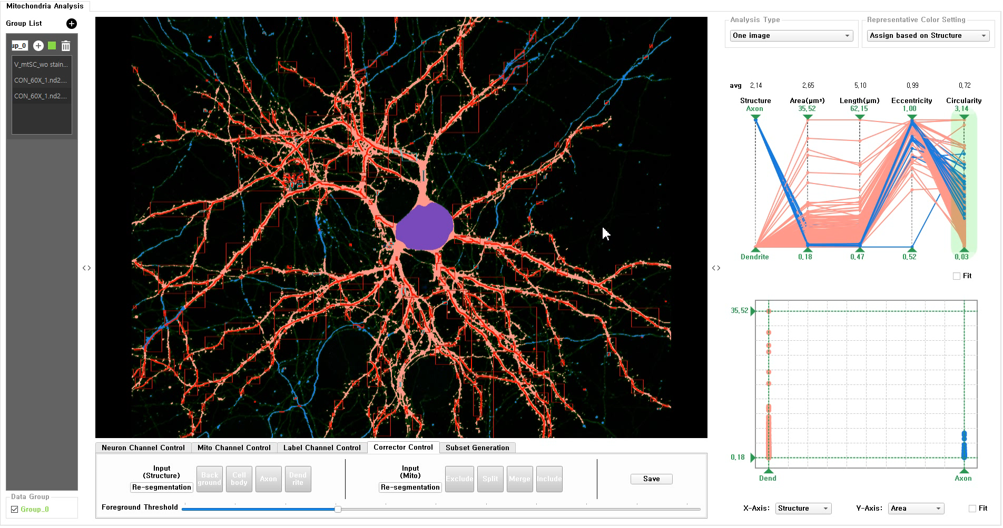
Mitochondria proofreading (Demo: Exclude)

Slide 8
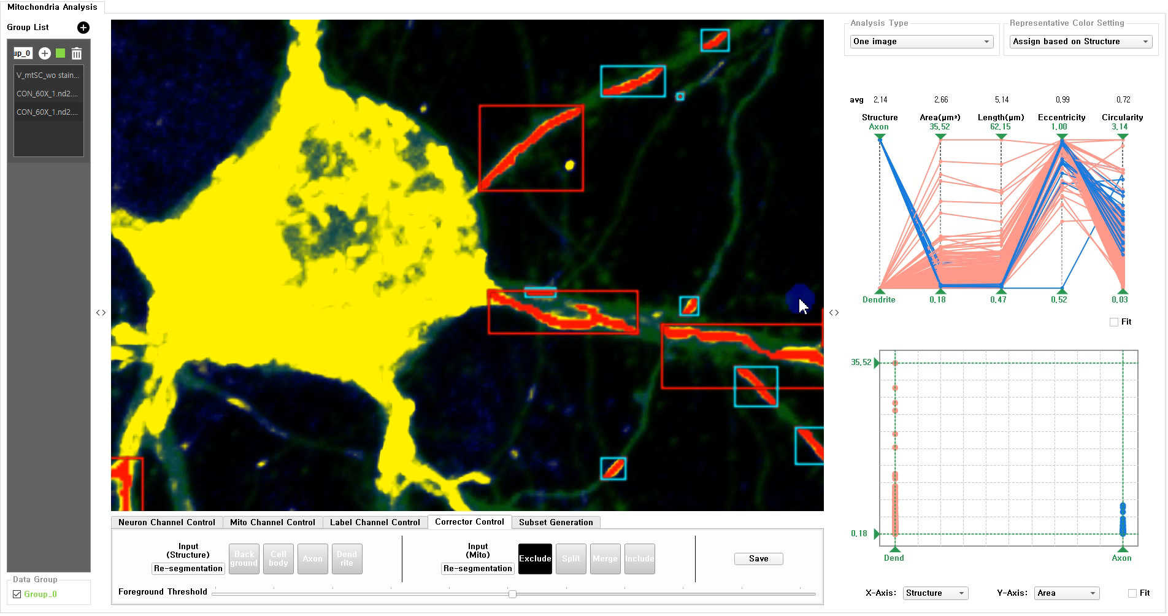
Mitochondria proofreading (Demo: Split)

Slide 9
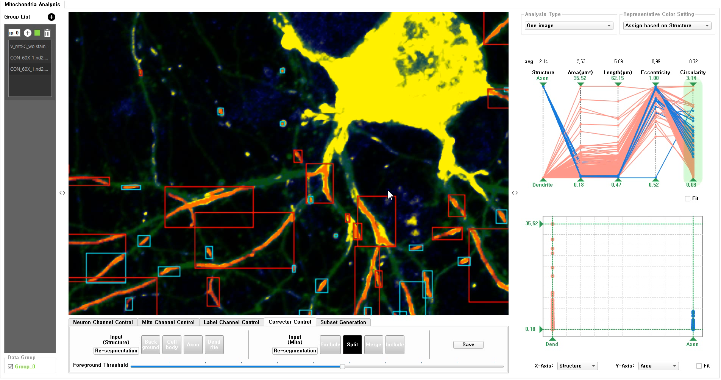
Mitochondria proofreading (Demo: Merge)

Slide 10
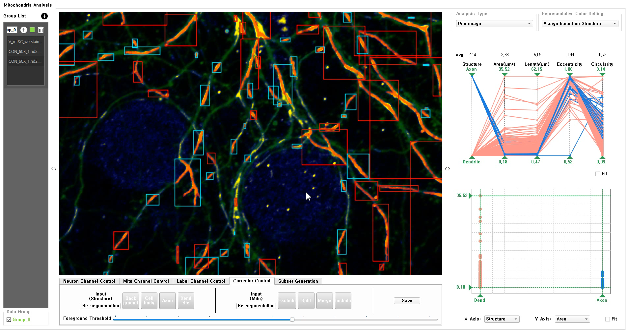
Mitochondria proofreading (Demo: Include)

Slide 11
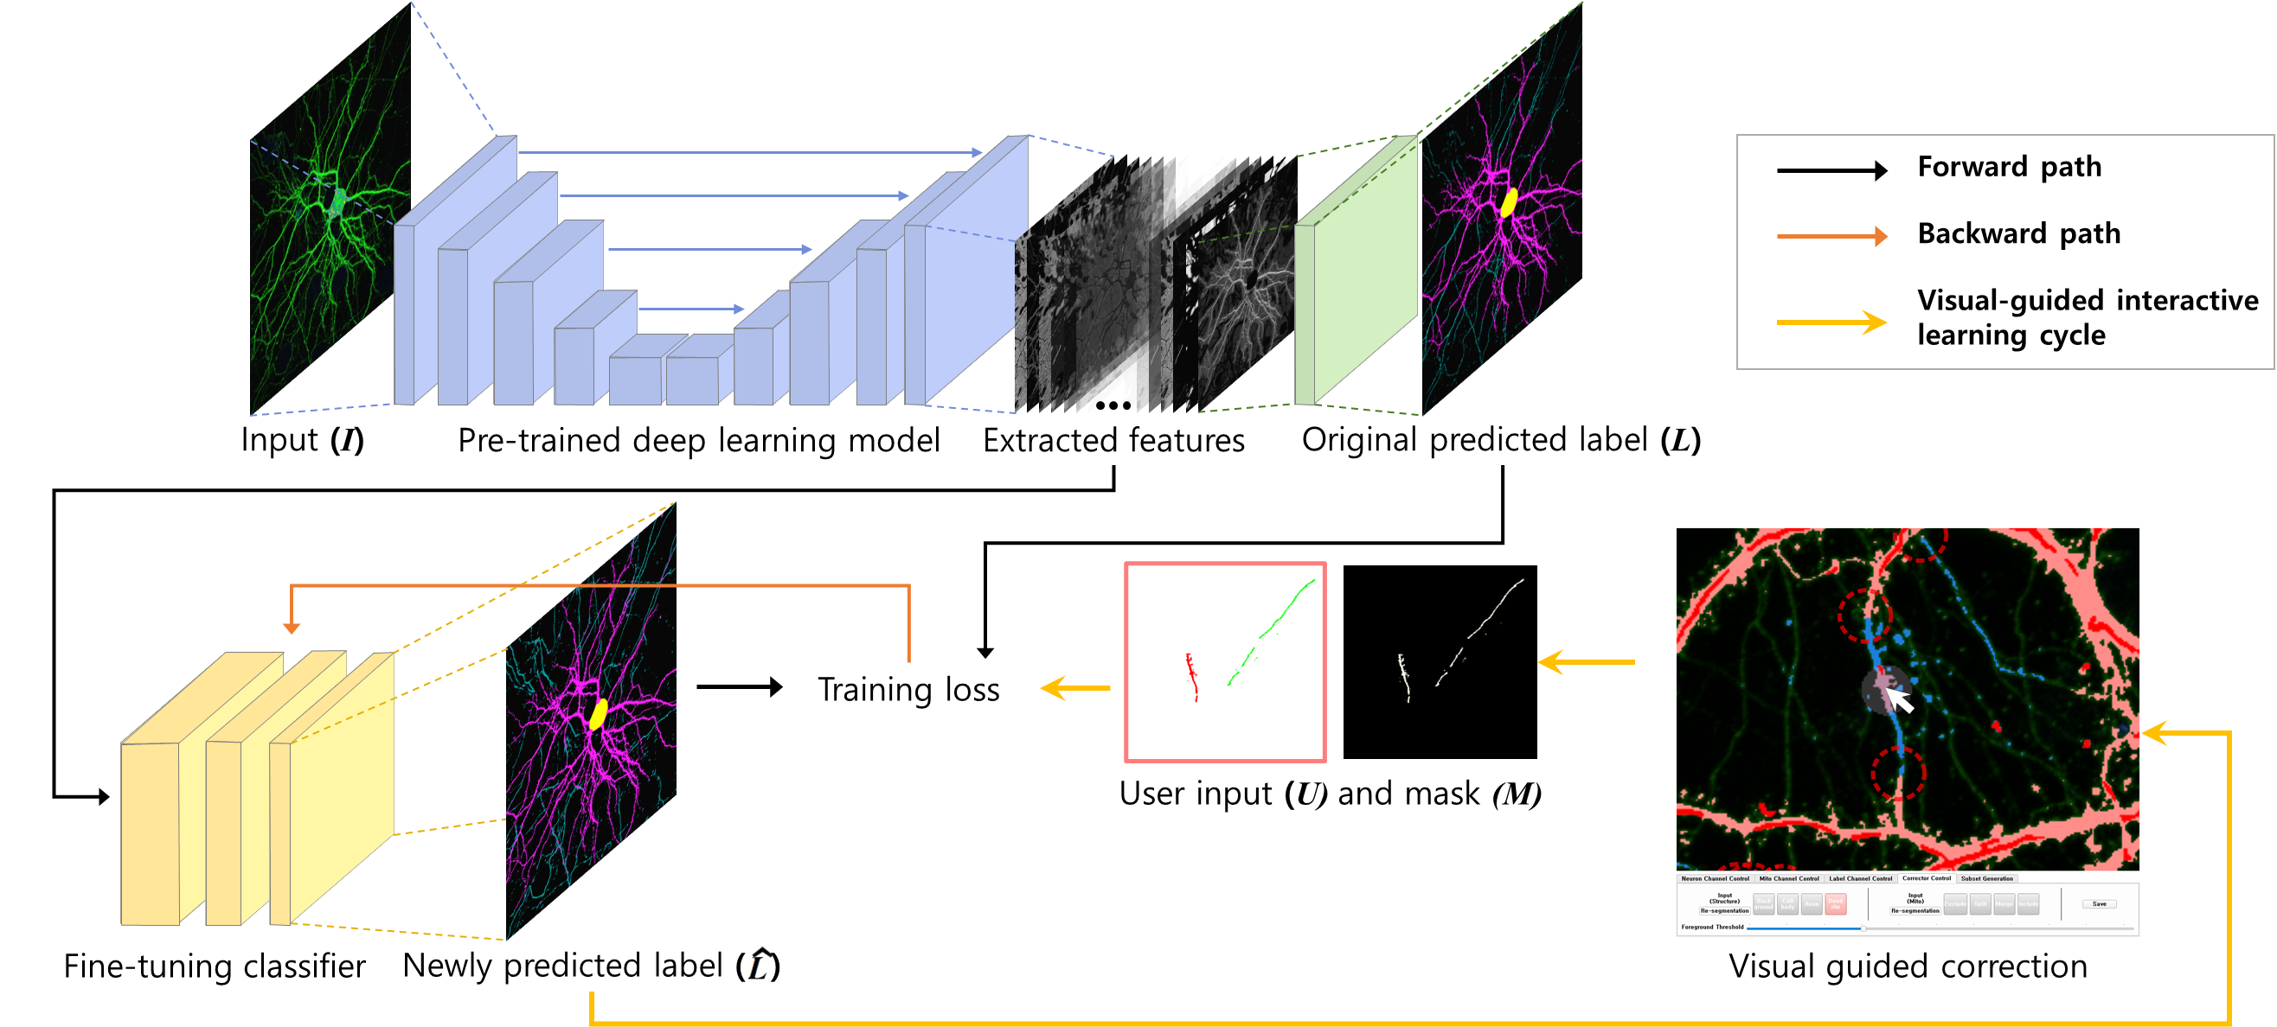
Fine-tunning &
re-detection
Fine-tuning deep learning through user interaction information in the similar way as the structure segmentation

Slide 12
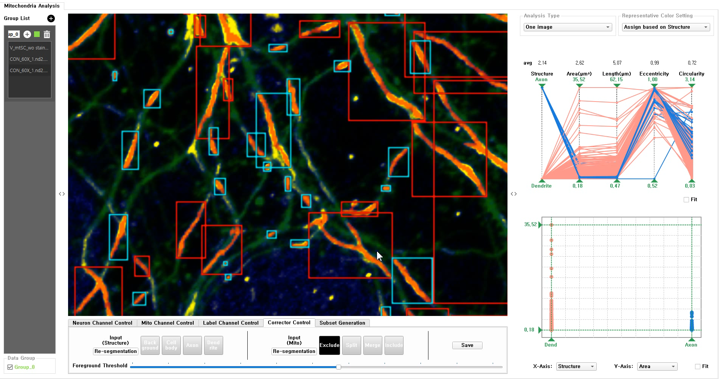
Fine-tunning &
re-detection
(Demo)

